Slide 1
RETAIL-GIANT SALES FORECASTING TIME SERIES ANALYSIS – CASE STUDY
Group Name : Best Riders
Anuj Arya
Asim Pattnaik
Mohammed Suhail Y
Rakesh Bosu

Slide 2
Business Objective:
“Global Mart” is an online store super giant having worldwide operations. It takes orders and delivers across the globe and deals with all the major product categories - consumer, corporate & home office.
The Sales/ Operations manager’s objective is to finalize the plan for the next 6 months, that would help to manage the revenue and inventory accordingly.
Objectives:
To forecast the sales and the demand for the next 6 months that would help you manage the revenue and inventory accordingly.
Since the store caters to 7 different market segments and in 3 major categories, we have to subset the data into 21 (7*3) buckets before analyzing these data and find out 2 most profitable (and consistent) segments from these 21 buckets.
Forecast the sales and demand for these 2 most profitable segments.

Slide 3
Problem Solving Methodology- CRISM-DM Framework
Understanding the Octives or desired results
Reviewing the available raw data present in the data file
Replacing all incompatible characters and converting some information to the required format in the above files
Selecting CRISP-DM model to analyze the data and get the desired result
Evaluating the selected model for it’s effectiveness Applying the selected model in analysis to get the desired result

Slide 4
Data Analysis, Cleaning and Preparation:
Global Superstore Dataset:
No. of sales datapoints : 51,290
No. of attributes : 24
Fields of Interest :
Market
Segment
Sales
Quantity
Profit
Found NA values in Postal code but that attribute is not of our interest.
Removed unnecessary columns and Formatted Order.Date as Date column and derived Month-Year attribute for analysis.

Slide 5
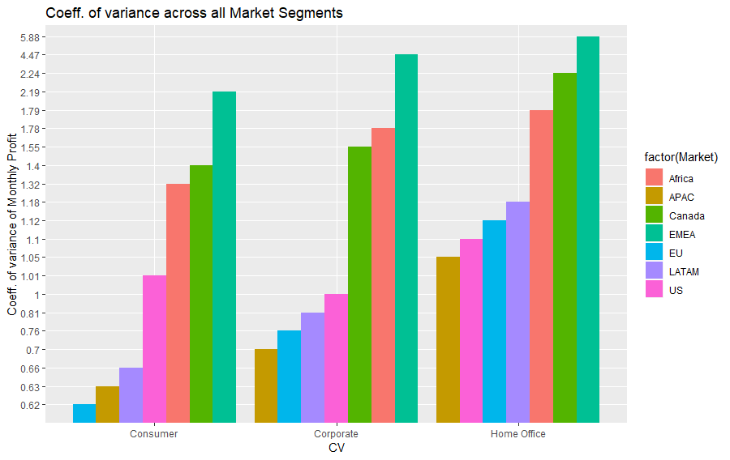
Calculating Coefficient of variation:
Computed Coefficient of Variation (CV) based on the aggregated profit.
The two Market Segments which have maximum and consistent Profit are
EU Consumer (0.624)
APAC Consumer (0.632)

Slide 6
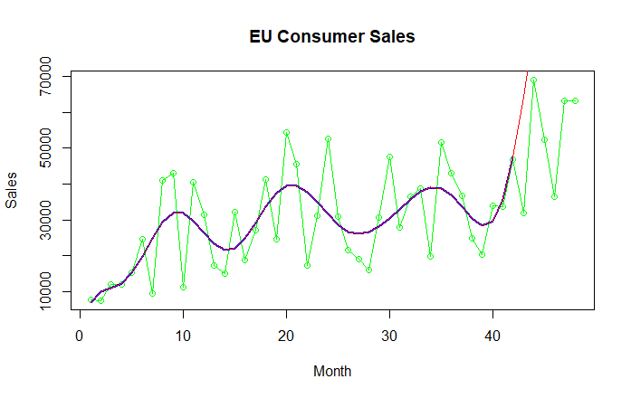
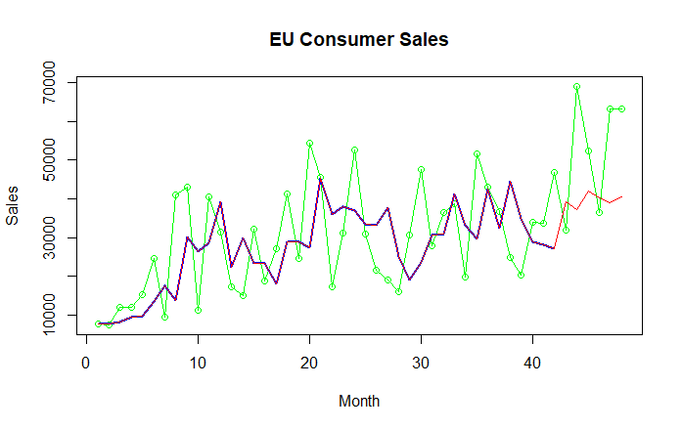
Model Building
EU CONSUMER SALES FORECASTING
Classical Decomposition
ARIMA(0,0,0) with zero mean
ADF Test: p-value = 0.01
KPSS Test: p-value = 0.1
AIC = 891.61
MAPE : 92.9578
Auto ARIMA
ARIMA(2,1,0)
ADF Test: p-value = 0.01
KPSS Test: p-value = 0.1
AIC = 897.67
MAPE : 28.9226

Slide 7
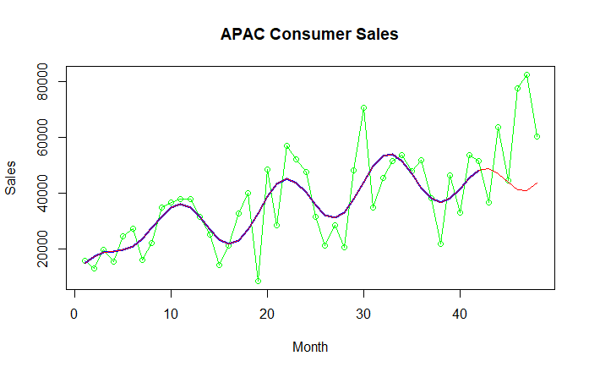
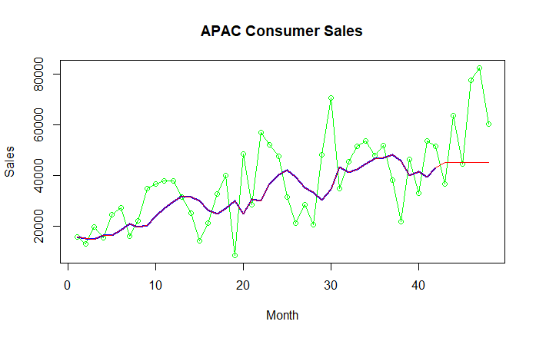
APAC CONSUMER SALES FORECASTING
Classical Decomposition
ARIMA(0,0,0) with zero mean
ADF Test: p-value = 0.01
KPSS Test: p-value = 0.1
AIC = 889.49
MAPE : 31.07429
Auto ARIMA
ARIMA(0,1,1)
ADF Test: p-value = 0.01
KPSS Test: p-value = 0.1
AIC = 898.23
MAPE : 27.68952

Slide 8
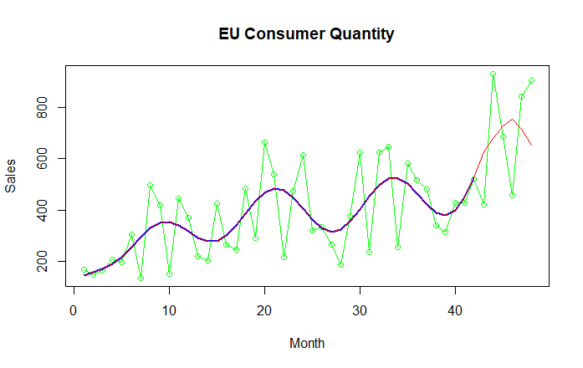
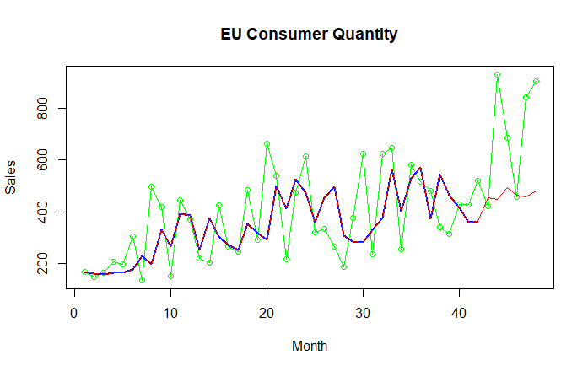
EU CONSUMER QUANTITY FORECASTING
Classical Decomposition
ARIMA(2,0,0) with zero mean
ADF Test: p-value = 0.01
KPSS Test: p-value = 0.1
AIC = 497.79
MAPE : 31.45475
Auto ARIMA
ARIMA(2,1,0)
ADF Test: p-value = 0.01
KPSS Test: p-value = 0.1
AIC = 529.8
MAPE : 30.13319

Slide 9
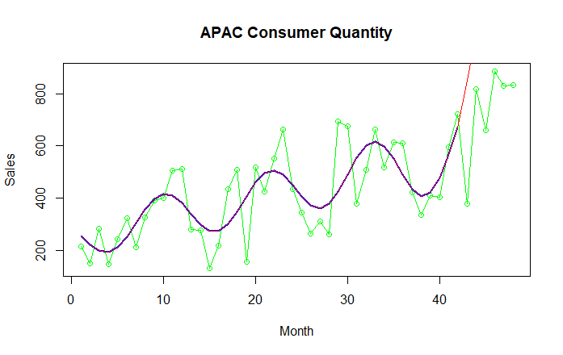
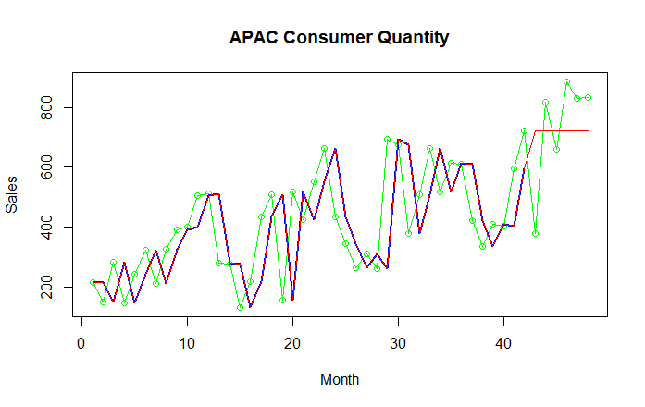
APAC CONSUMER QUANTITY FORECASTING
Classical Decomposition
ARIMA(0,0,0) with zero mean
ADF Test: p-value = 0.01
KPSS Test: p-value = 0.1
AIC = 511.14
MAPE : 62.10289
Auto ARIMA
ARIMA(0,1,0)
ADF Test: p-value = 0.01
KPSS Test: p-value = 0.1
AIC = 534.14
MAPE : 26.24458

Slide 10
Conclusion
The EU Consumer and APAC Consumer Market Segments are the two most consistently profitable segments.
In all the predictions, Auto ARIMA performed better than classical decomposition method.
MAPE values is low for all Auto ARIMA models and the residuals of all the segment predictions turned out to be white noise.
Business Implications:
The Sales/Operations Manager can focus primarily on EU and APAC Consumer Segments to maintain profit.
The predictions show that sales and quantity are both on the rise for the next 6 months and should be stable based on historical sales trend analysis.

